Slide 1
What Might Happen if you Attended a Consumer Product Event?

Slide 2
Here are some results from our clients.

Slide 3
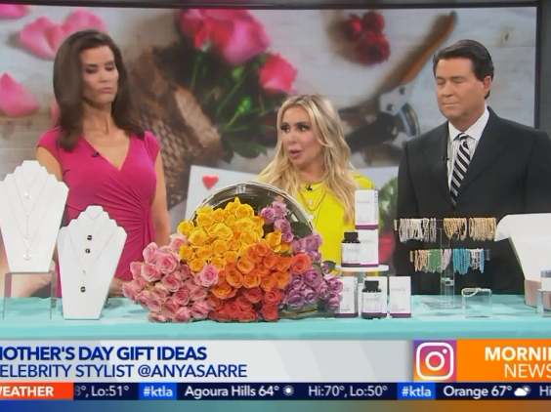
These products landed on the #1 most viewed morning TV show in the US: Los Angeles’ KTLA Morning News.

Slide 4
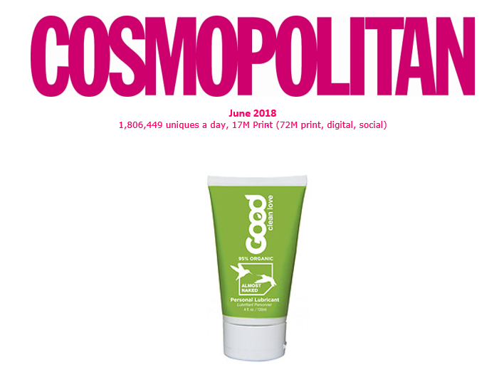
72M eyeballs landed on Good Clean Love in Cosmo’s print, digital and social

Slide 5
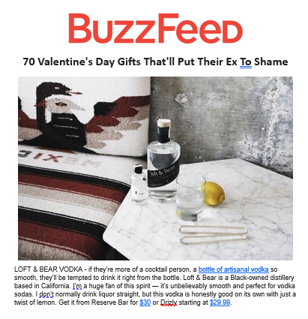

Slide 6
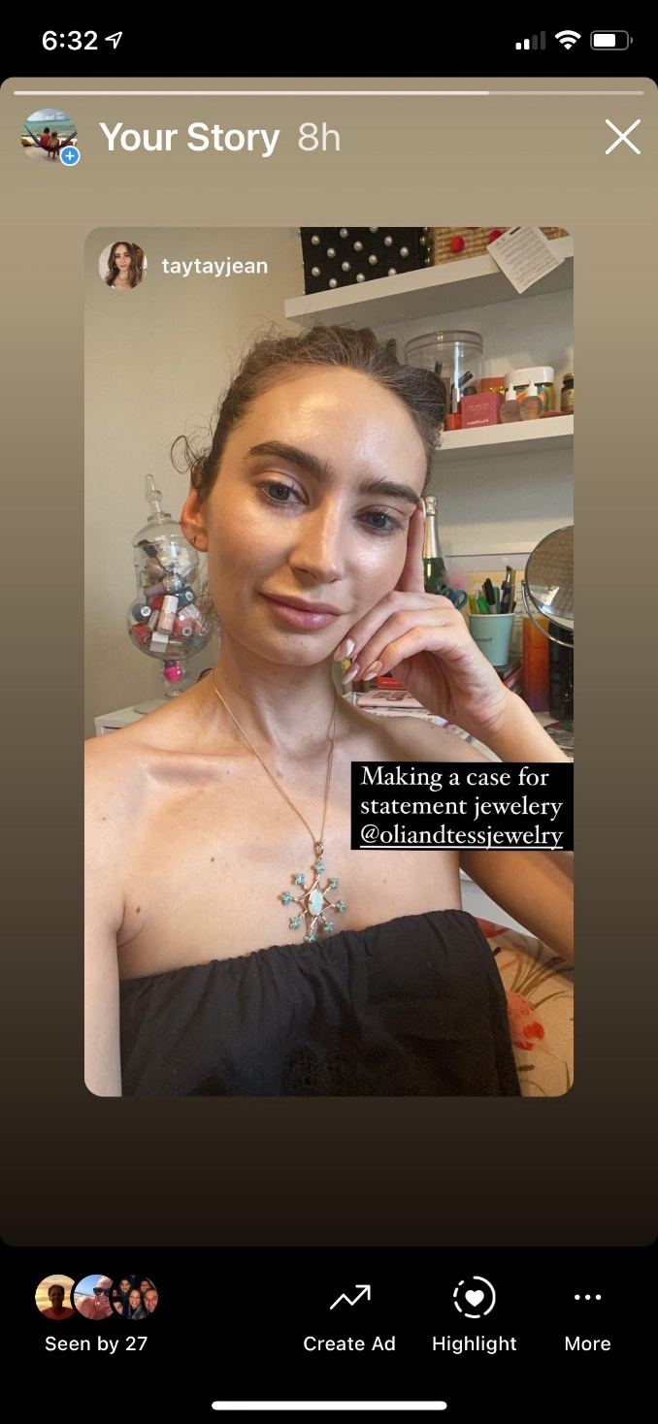
This influencer is wearing a client's necklace. She writes for Cosmo, Oprah, Elle, Refinery29 and many others

Slide 7
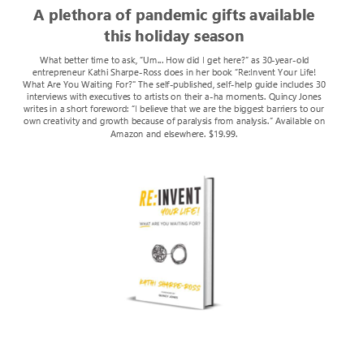
The #1 press outlet in the world!

Slide 8
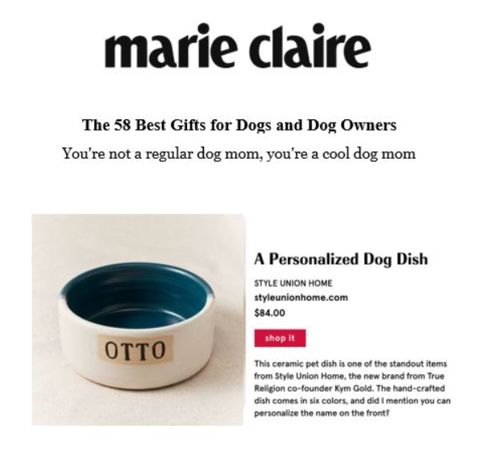
This placement turned this dog dish into a #1 selling product as a result of this placement

Slide 9
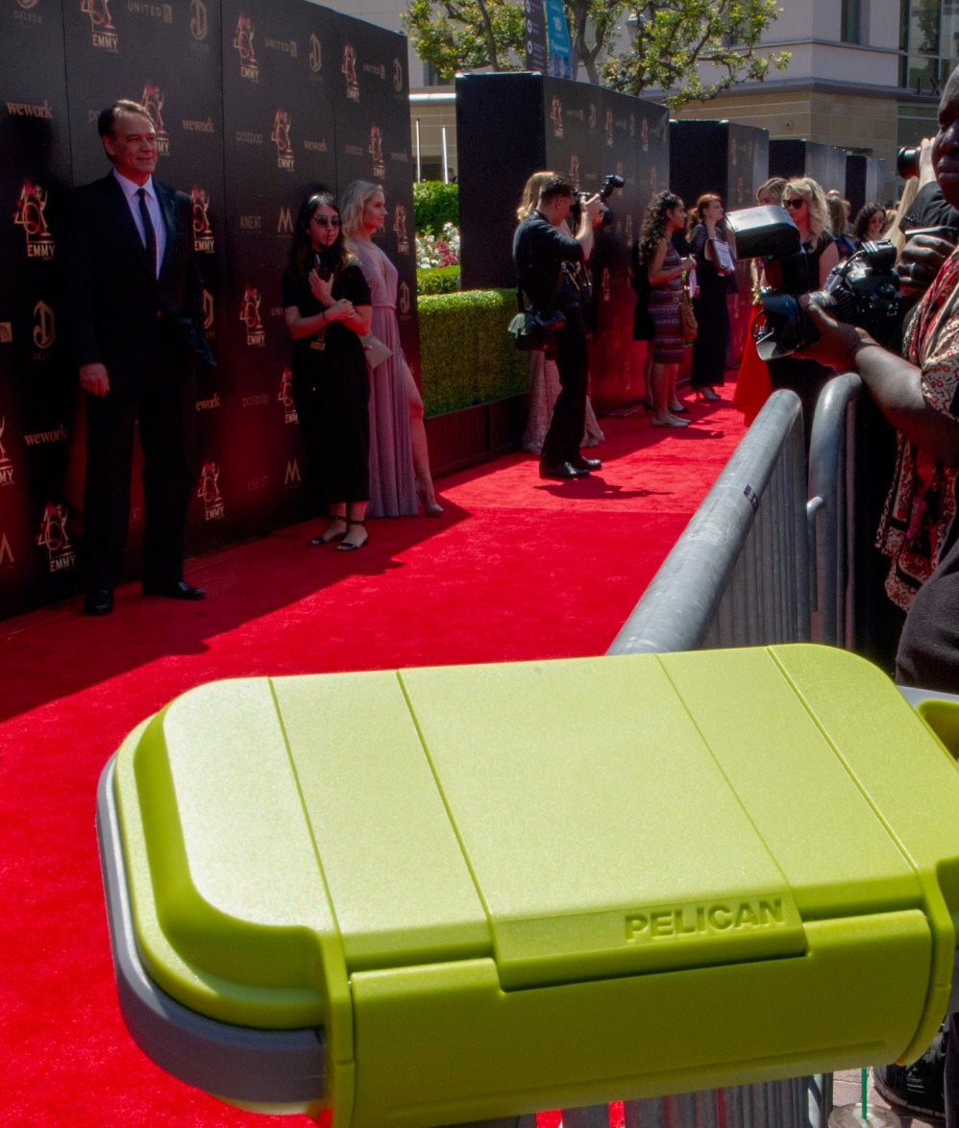
On the red carpet at the Emmys for Pelican? Priceless

Slide 10
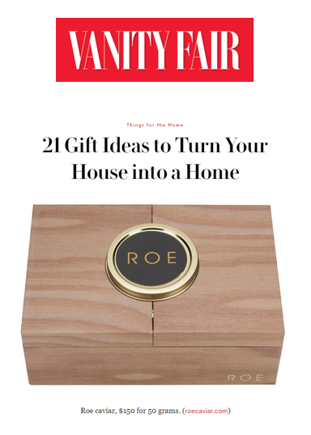
The annual gift guide seen by 1,193,2677

Slide 11
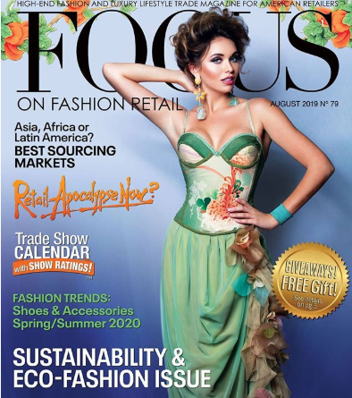
Cover story for this fashion designer!

Slide 12
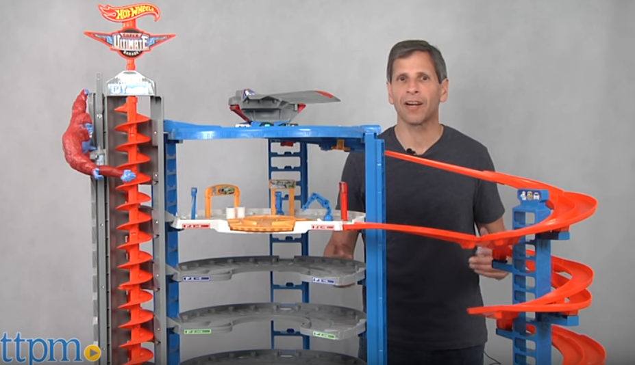
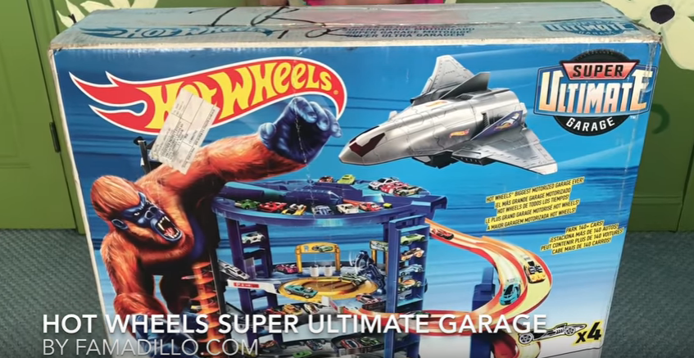

Slide 13
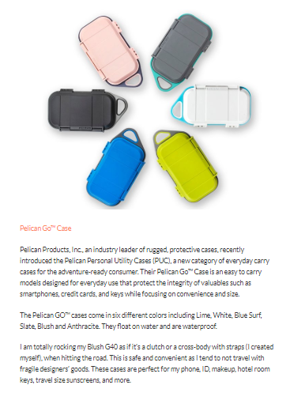
The news app on iPhones globally: 85M readers a day

Slide 14
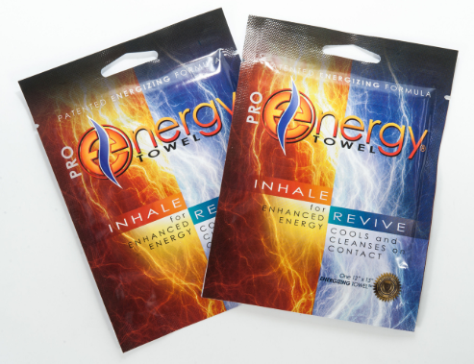
This product was reported about in all of these magazines (and their .coms)
Seen by 18M, would have cost
$713,875.00, ROI: 167%

Slide 15
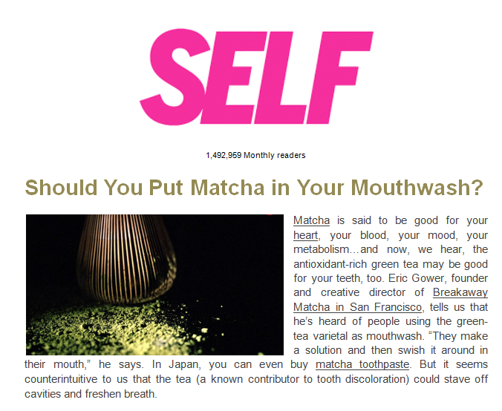
Breakaway Matcha didn’t even meet this reporter in person – but pitched from our list
Seen by 1.4M

Slide 16
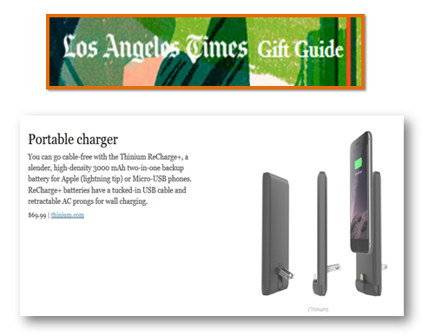
Thinium came to our Holiday Gift Guide event in September – and look what happened a month later

Slide 17
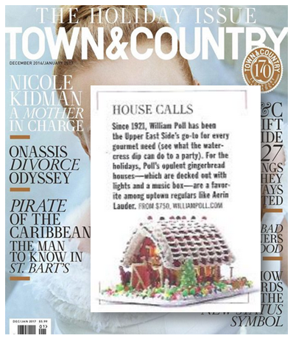
Stanley Poll, New York City’s epicurean must-stop sent their gingerbread house to Town & Country
An ad in this mag would have cost $115,580
It’s read by 812,000 perfectly matched customers for his business

Slide 18
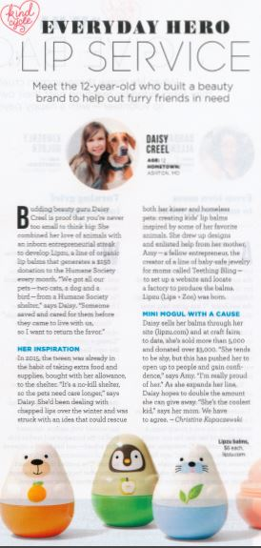
This page would have cost $258,000
ROI: 600%

Slide 19
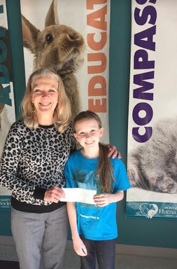
“Dear Consumer Product Events: Since the Lipzu article came out in Good Housekeeping, I have gotten 687 orders! Today, I was able to give the Humane Society a $1000 check. ”
Daisy, 10-year old creator of Lipzu

Slide 20
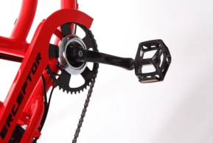
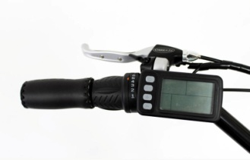
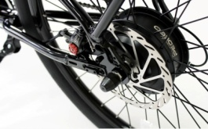
This client got several placements at CPE, including Maxim, the premier men’s magazine with
8,705,000 monthly readers

Slide 21
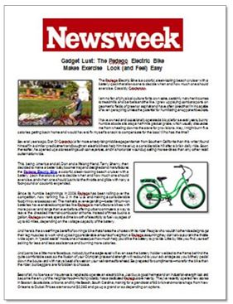
This client landed a full page story in Newsweek magazine. This page would have cost $20,000 and it’s the second largest biz magazine in the US!

Slide 23
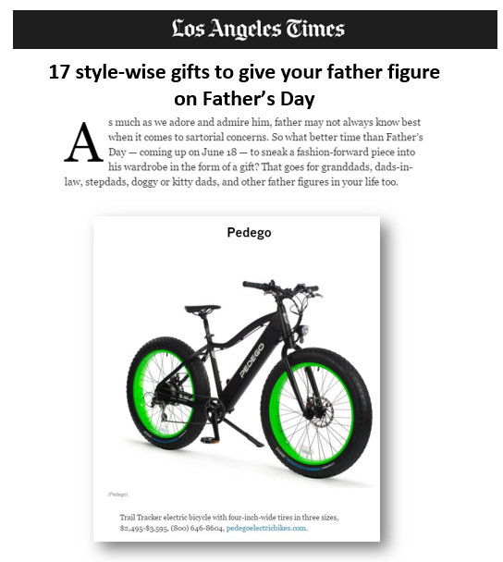
The Father’s Day Gift Guide seen by 2.4M

Slide 24
How many saw this? Oh, only 2.5 million

Slide 25
5,576,000 readers saw this client’s gowns Had she bought an ad, it would have cost $85,399 .

Slide 26
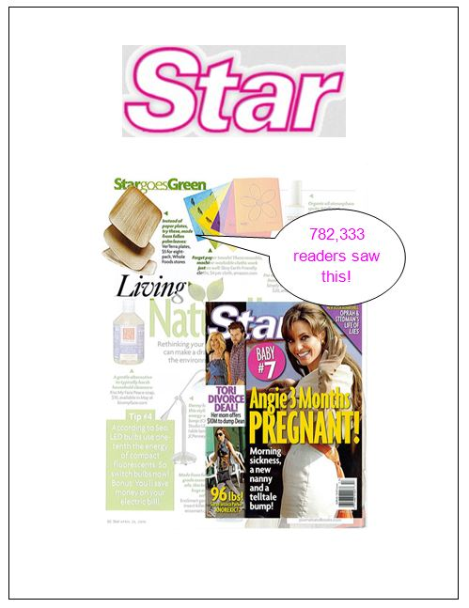
Verterra makes disposable plates from fallen leaves in the forest
782,333 readers were introduced to this amazing product when they met the editors at a Consumer Product Event

Slide 28
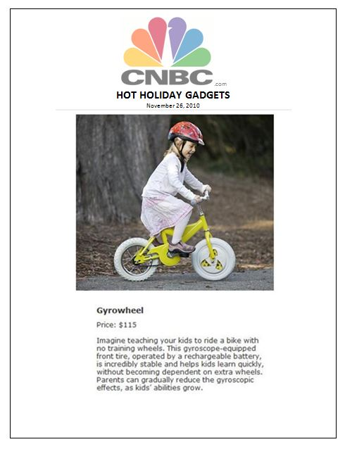
This product only got their product in front of 343,000 daily viewers - not a bad return on investment

Slide 29
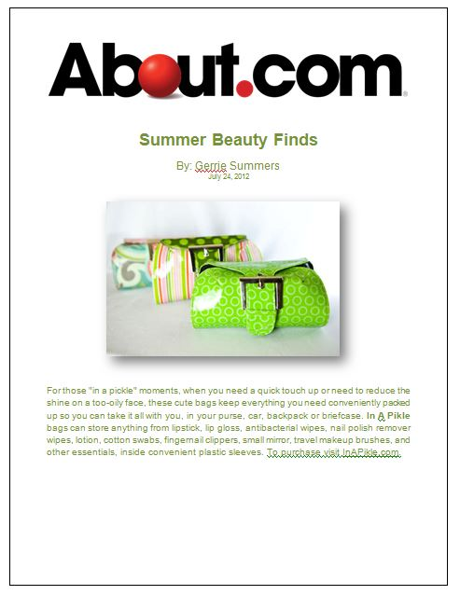
Read by 85 million

Slide 30
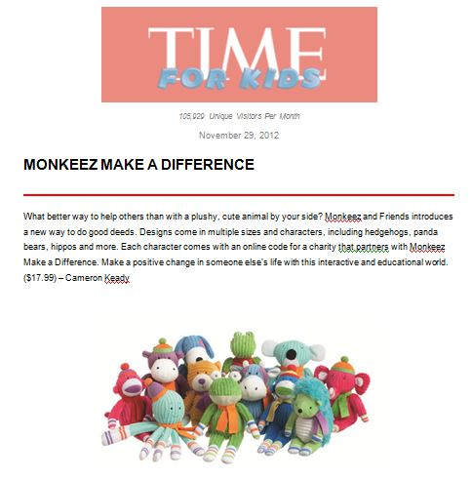
What if you got into TIME for Kids magazine?
This placement was seen by 3,804,507 students and 143,172 teachers

Slide 31
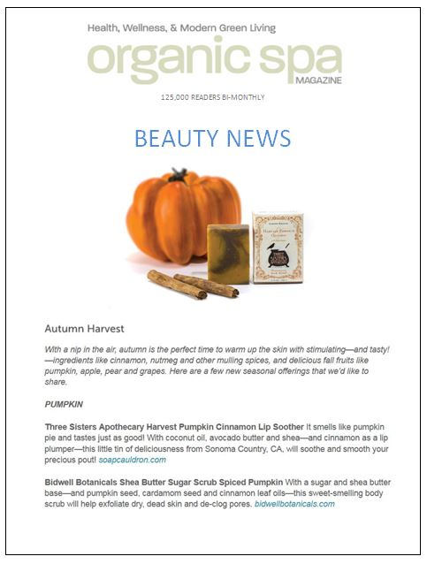
This client met the editors of Organic Spa magazine at the Holiday Gift Guide Consumer Product Event and got into this gorgeous publication read by 125,000

Slide 32
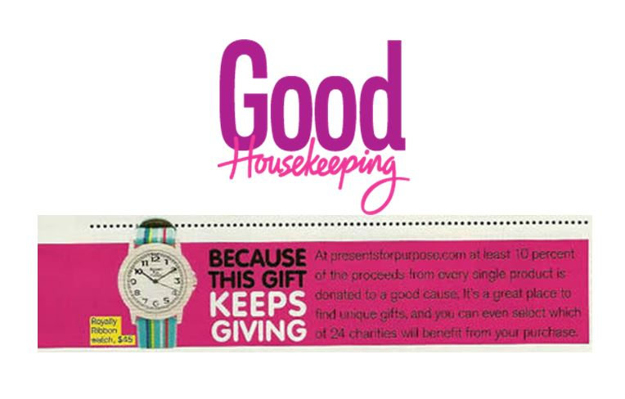
Presents for Purpose met the editors from Good Housekeeping, read by 300,000 women who could use their e-tailing service to buy gifts – and benefit charities

Slide 33
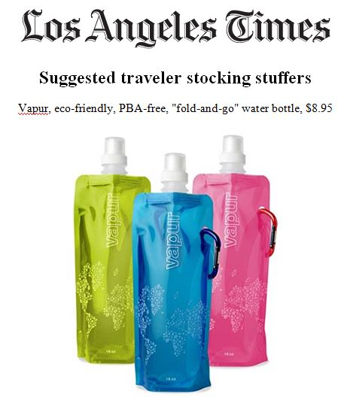
Vapur’s coloful water bottles were exposed to 3,527,304 water bottle-toting Angelenos.

Slide 34
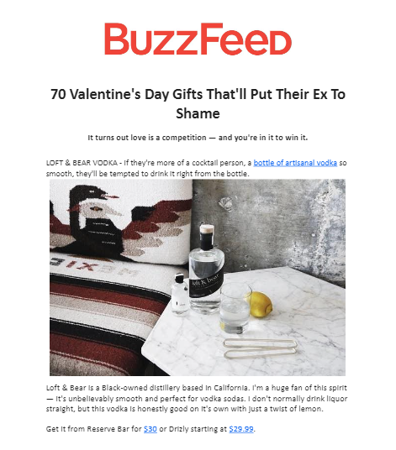

Slide 35
Consumer Product Events connects consumer packaged goods with the press who are looking to report about them.
These are real results from our clients who have attended our showcases in New York City and Los Angeles.
We provide direct access to our little black book of contacts most likely to report about a product like yours.
There’s no place in the world where you’d ever meet all these people at once.

Slide 36
You could be next.

Slide 37
Contact us @
310.317.1543

